Slide 1
ECE 3300L
Lab 9:PWM and RGB LEDs
Instructor: Dr. Mohamed El-Hadedy
Sami Elias, Joseph Popoviciu

Slide 2
Objective
Use PWM to control an RGB LED. Be able to select color and resolution of the LED

Slide 3
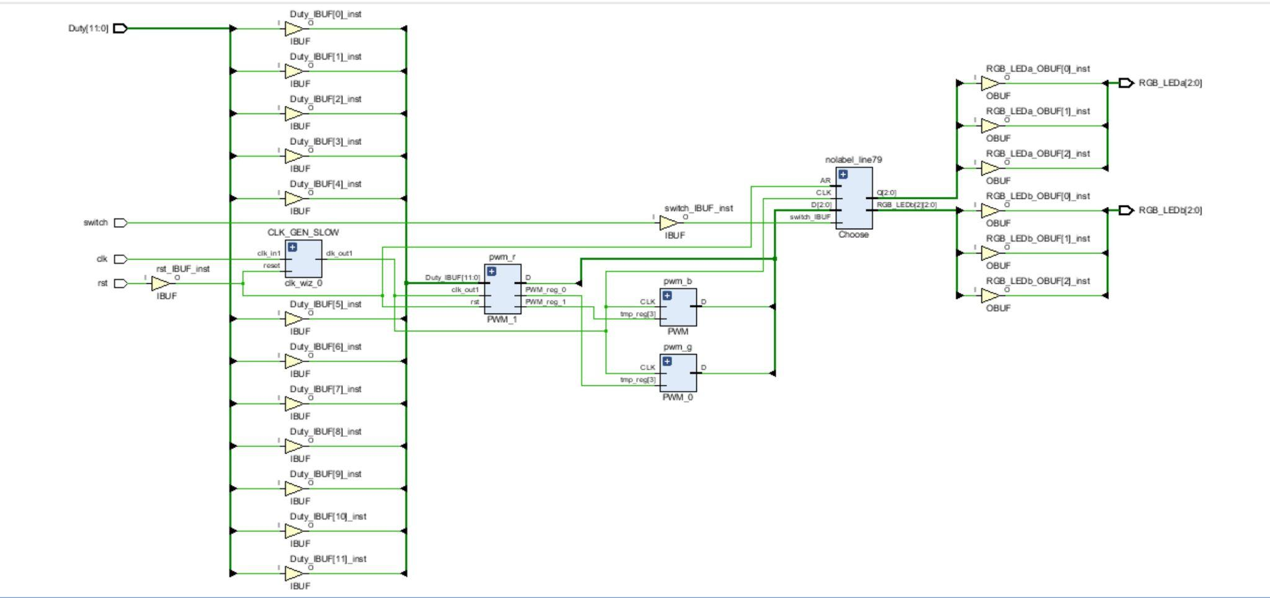
Schematic

Slide 4
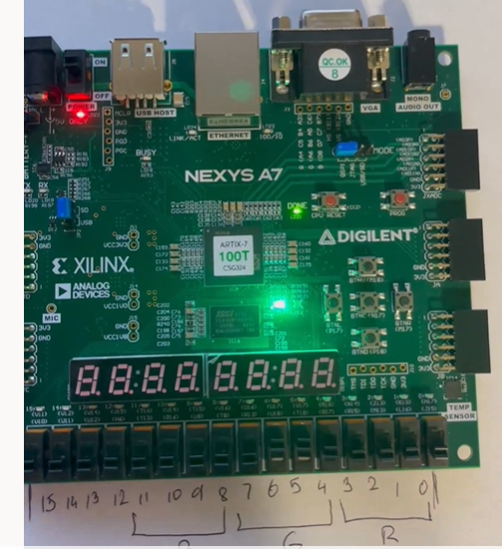
Result
There are four switches per color
The more significant the switch, the
Brighter the light will be

Slide 5
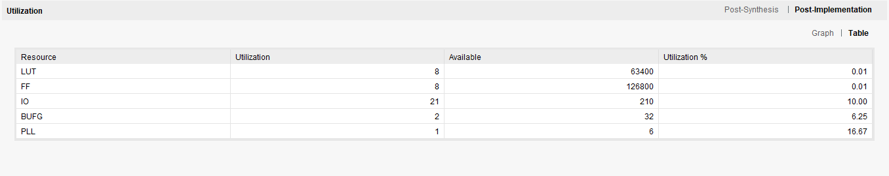
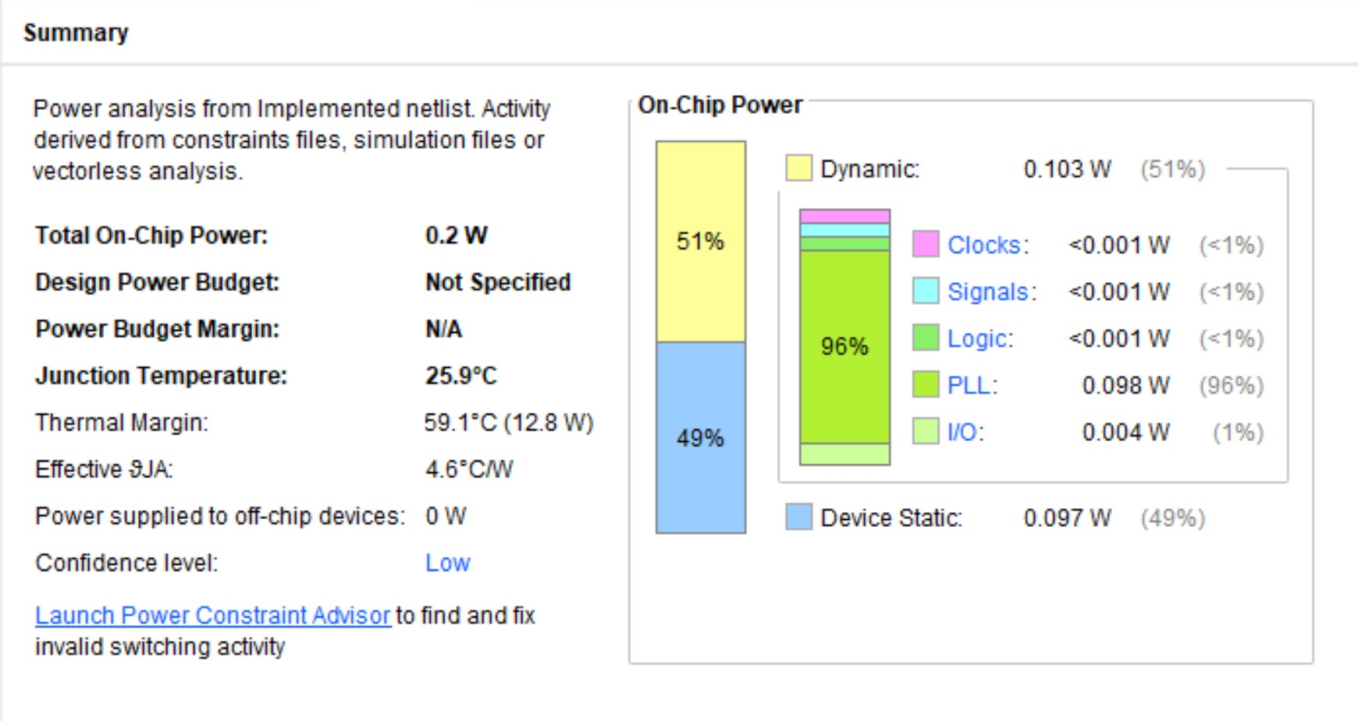
Utilization

